Slide 1


CYBERSECURITY ATTACKS

Slide 2



PROBLEM STATEMENT
In the era of organisations facing constant threats and having vulnerabilities to cyber attacks. It is really important to perform advanced analytics to identify patterns, trends, and vulnerabilities in cybersecurity attacks. In this project through Exploratory Data Analysis I mainly tried to understand the patterns of cybersecurity attacks, logical ports that have been attacked along with the common type of attacks in various time periods in a day. The main goal is to improve the protection against vulnerabilities by analysing the origin and type of attack.

Slide 3



INTRODUCTION
Most of the organisations nowadays are vulnerable to cyber threats because of the technology advancement, networks, social media. Data breaches are typical cyber attacks which have a huge impact on the organisations that store their sensitive customer data in the form of huge chunks in company servers without proper safety measures. Cyber
security criminals target the high volumes of sensitive and valuable customer data maintained by organisations and use this data for their own advantage.To prevent these ransomware attacks, the organisations must take preventive measures to stop ransomware attacks, such as adopting sophisticated security systems, regularly assessing risks, threat intelligence tools and educating employees to spot phishing efforts. Regular hardware and software updates need to be done in order to reduce the risks. Every organisation should have a predesigned incident response strategy which includes steps like restoring data from safe backups, reporting the breach to law authorities, and isolating compromised systems to apply during attacks.

Slide 4

Data Set
For representing the cybersecurity attacks I chose a dataset from Kaggle. This dataset contains several variables which provide the information related to the nature of the attacks and . Attributes:
● Attack category : Type of registered cybersecurity attack
● Attack subcategory: A subcategory of the type of cybersecurity attack registered
● Attack Name: The technical name for the cybersecurity attack
● Time: Start and end date of the attack in timestamp format
● Protocol: The protocol used for the attack.
● Source IP: IPv4 address where the attack came from.
● Source Port: The logical port where the attack came from.
● Destination IP: Destination IPv4 address.
● Destination Port: Logical destination port

Slide 5

DATA LOADING AND PREPROCESSING
Data
Cleaning
Removed Duplicates
Invalid Port Filtering &
Standardization:
Feature Engineering

Slide 6



DATA LOADING AND PREPROCESSING
Data Cleaning:
Created a backup of the original dataset (df_before_cleaning) for reference.
Split the Time column into Start time and End time and dropped unnecessary columns like Time.
Addressed missing values:
Replaced null values in Attacksubcategory with "NotRegistered".
Analyzed the AttackReference column and found Reconnaissance attacks had the most null values (90.11%).
Data Cleaning

Slide 7

DATA LOADING AND PREPROCESSING
Data Cleaning:
Data Cleaning

Slide 8

REMOVED DUPLICATES
Identified and removed 6 duplicate rows.
Removed Duplicates

Slide 9
Invalid Port Filtering
Filtered out rows where SourcePort or DestinationPort had values outside the valid range (0-65535).
Standardization:
Converted text in Protocol and Attackcategory columns to uppercase, and merged duplicate categories (e.g., Backdoors -> Backdoor).
Invalid Port Filtering &
Standardization:

Slide 10
Feature Engineering:
Converted Start time and End time to datetime objects.
Added new features: Duration, Hour, Month, and Day for time-based analysis.
Feature Engineering

Slide 11
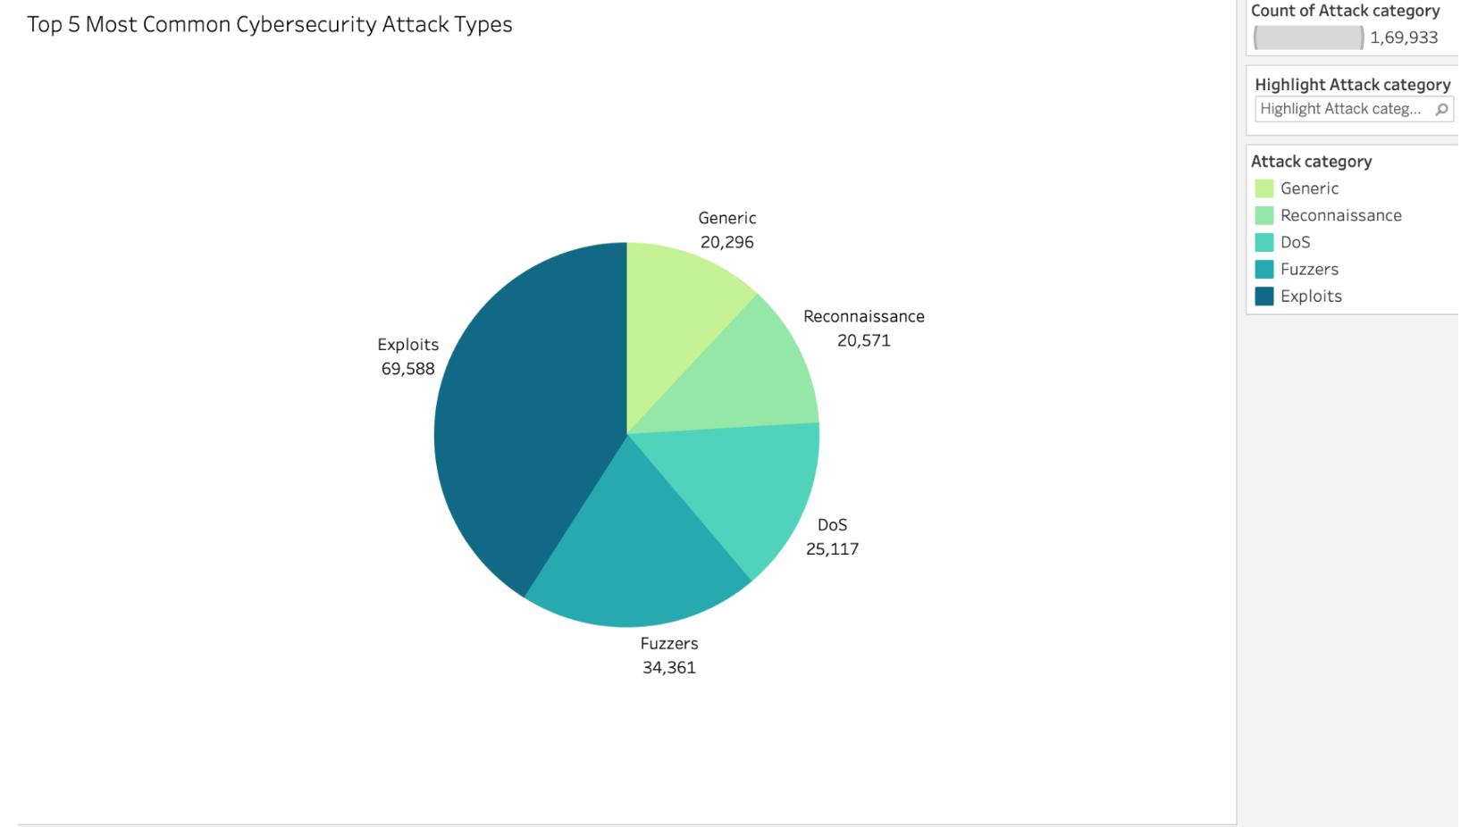
Top 5 Most Common Attack Categories

Slide 12
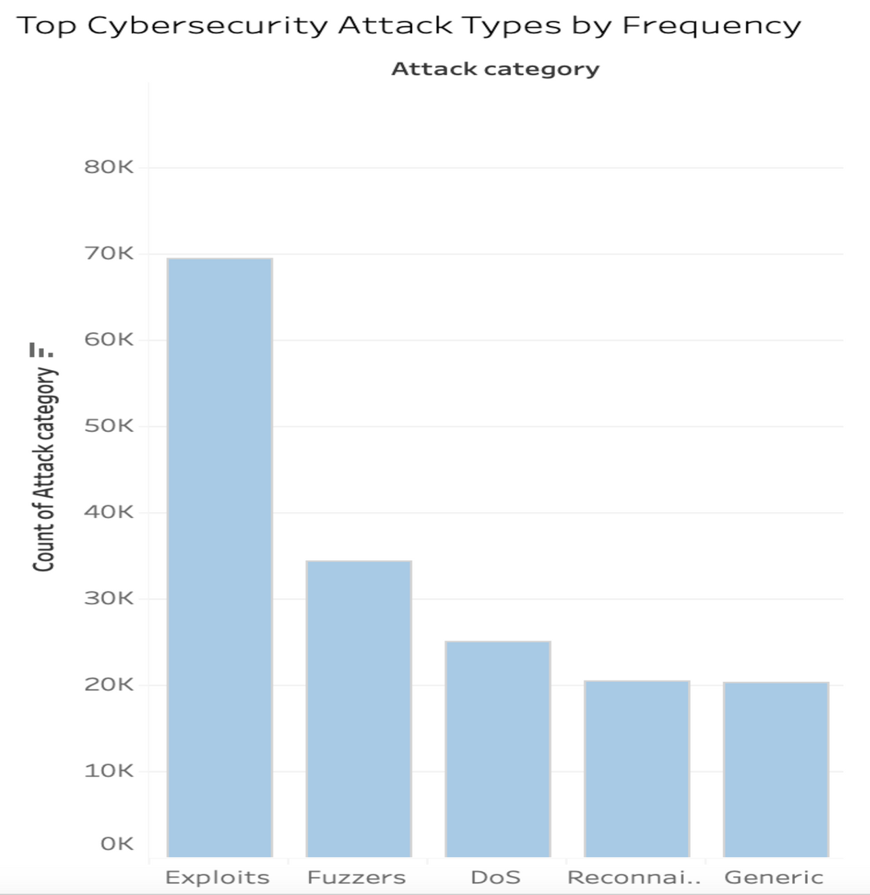
Attack Category with the Highest Frequency

Slide 13
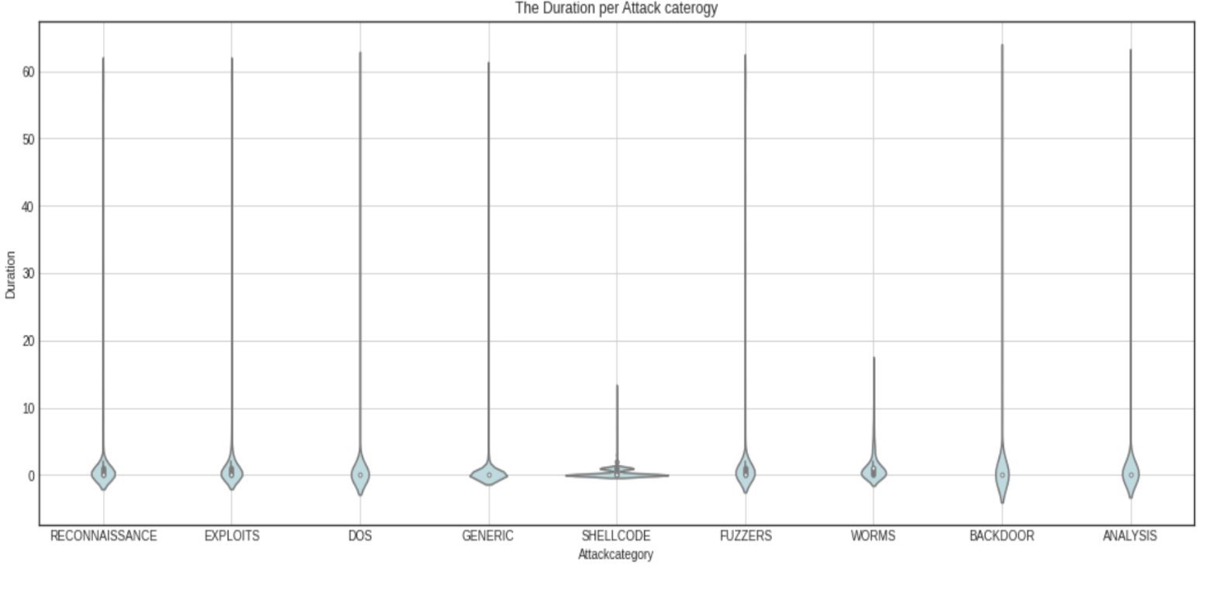
Distribution of Attack Durations by Category

Slide 14
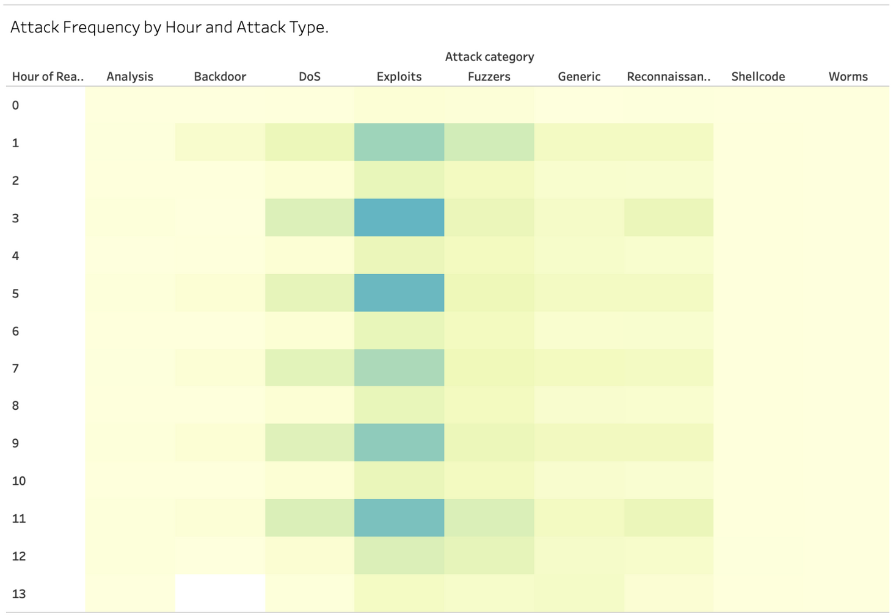
Attack Frequency by Time and Type

Slide 15
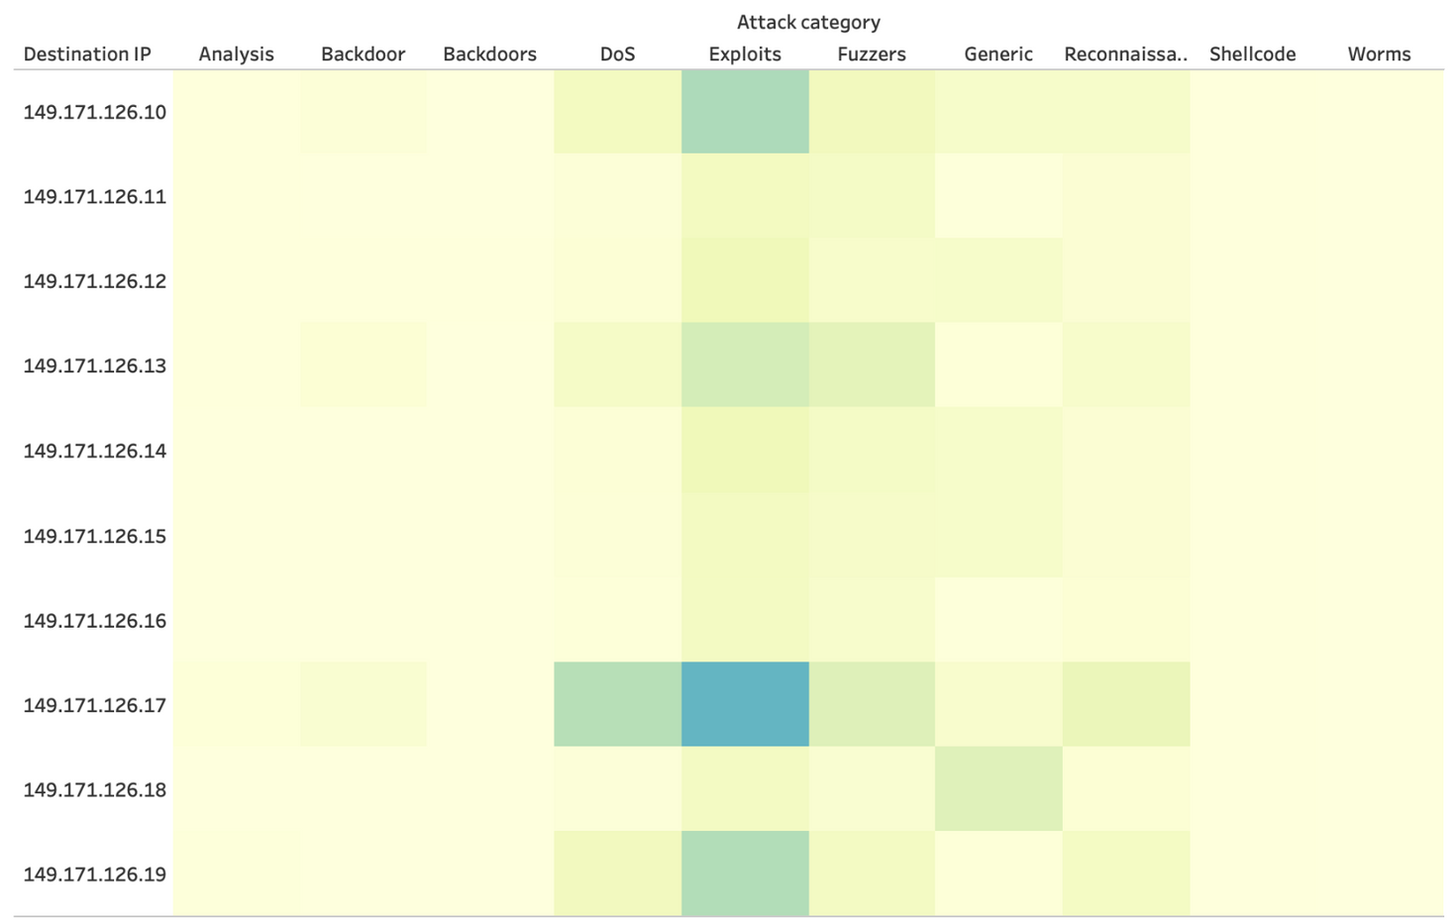
Attack Frequency by IP and Type

Slide 16
Key Insights
Common Attacks: Exploits, Fuzzers, and DoS are the most frequent, emphasizing the need for focused countermeasures.
Targeted Servers: Certain machines (e.g., 149.171.126.17) and specific ports are more prone to targeted attacks.
Attack Patterns: Many attacks occur during odd hours, revealing vulnerabilities in monitoring during these times.
Duration Insights: Most attacks last under a minute, but certain categories like Shellcode and Worms show unique patterns (e.g., bimodal or short durations).

Slide 17
Conclusion
Overall, I learned how to apply Exploratory Data Analysis (EDA) to real-world cybersecurity data, clean and preprocess datasets, and create meaningful visualizations in Tableau to identify trends, patterns, and vulnerabilities. This knowledge can directly help organizations strengthen their cybersecurity defenses.

Slide 18


Thank You

